Slide 1
Hospital Management System Analytics
Improving Operational Efficiency and Patient Care
PRESENTED BY: VAISHNAVI SWAPNIL RAUT

Slide 2
Goal of the Project
The project aims to analyse patient demographics, appointment trends, doctor performance, and hospital efficiency KPIs in order to identify bottlenecks, reduce appointment cancellations, optimize doctor workload distribution, and provide better patient engagement.
Improving Operational Efficiency
Patient Care

Slide 3
Hospital System Problem
The Hospital System was struggling with:
Difficult to track cancellations, reschedules, and no-shows.
Hard to identify bottlenecks in scheduling and resource allocation.
No systematic way to balance workloads across specialties.
Potential gaps in follow-up care and continuity for chronic patients
Delayed response to operational inefficiencies and patient needs.

Slide 4
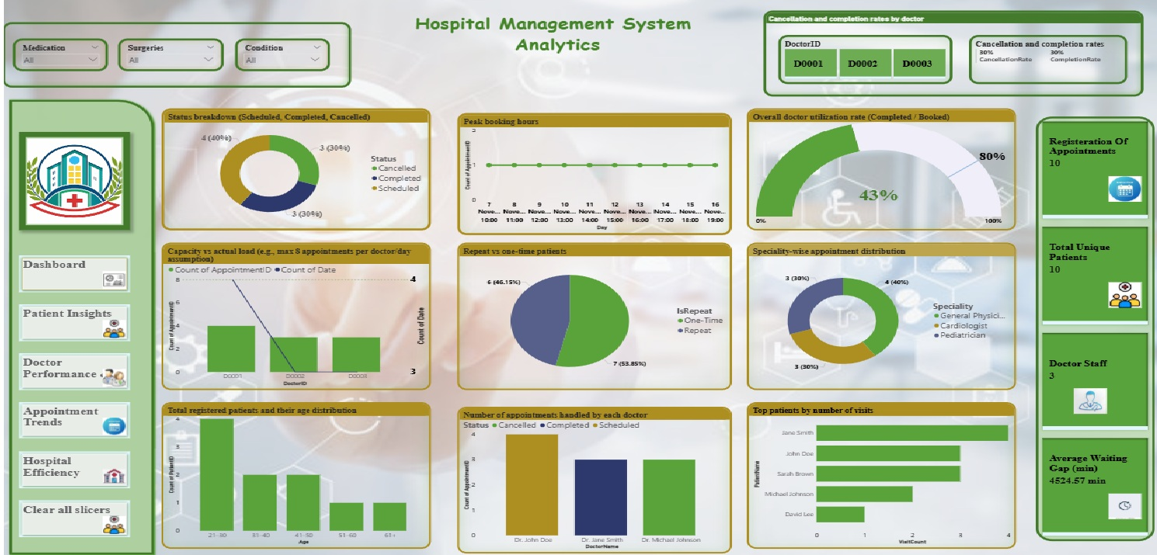

Slide 5

Strategic Recommendations for Hospital Management
System Management
System Management ensures that hospital operations are data-driven, secure, and efficient — enabling better patient care and optimized doctor utilization.
Best Practices
Regularly update and clean patient, doctor, and appointment data.
Track KPIs like utilization and cancellations continuously
Automate reminders and follow-ups
Balance workloads across specialties
Strategy
Reduce appointment cancellations through reminders and follow-ups.
Optimize doctor schedules to enhance utilization.
Personalize care plans for frequent patients.
Monitor peak times and adjust staffing as needed.

Slide 6
Thank You!

